Slide 1


Slide 2








Slide 3






Slide 4



Slide 5


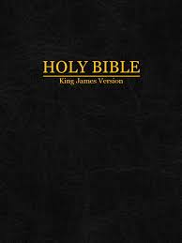
Introduction
24 Hours
Bible Study

